Slide 1

18CSE392T – Machine Learning I
Department of Data Science and Business Systems

Slide 2
Agenda
What is ML ?
Why do we need ML?
Where do we use it ?
1
2
3

Slide 3
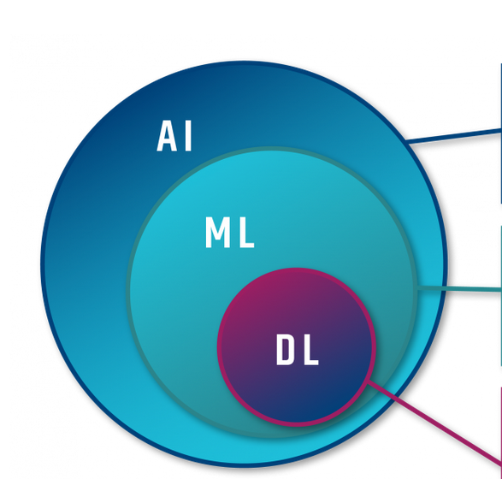
Introduction
Artificial Intelligence
Machine Learning
Deep Learning

Slide 4
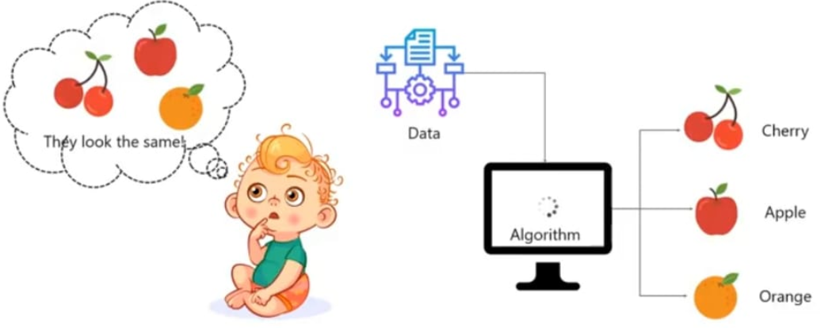
Child Learning

Slide 5
Learning
Past experience
Learning from others
Machines need instruction from humans

Slide 6
Machine Learning – In general
A subset of Artificial Intelligence
Machines that learn automatically & improve from experience.
No explicit programme is needed.

Slide 7
Definition - ML
A set of methods that can automatically detect patterns in data, and then use the uncovered patterns to predict future data, or to perform other kinds of decision making under uncertainty.

Slide 8
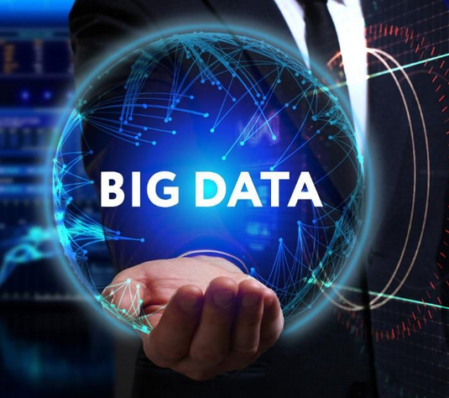
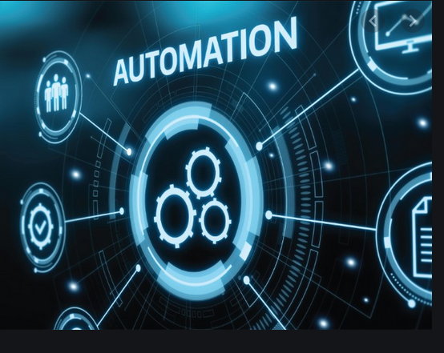
Need for ML
Huge amount of data (Big data)
Automated methods of data analysis

Slide 9
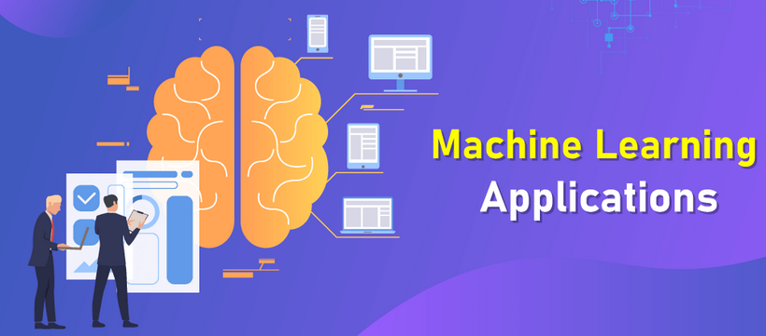

Slide 10
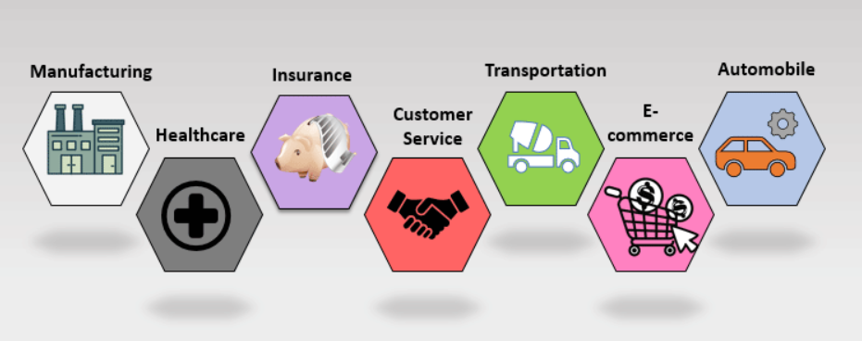
Few ML Applications

Slide 11


